Slide 1
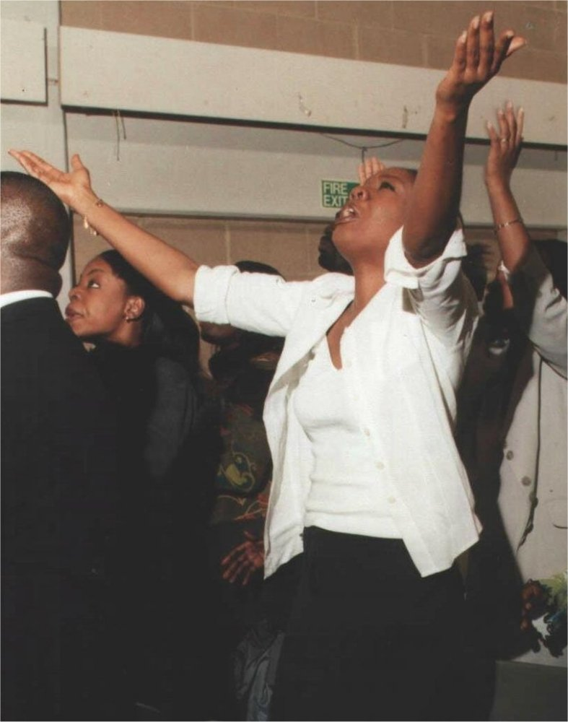
What Is Spiritual Warfare?
Lecture 1 of the Spiritual Warfare Seminar
By John Edmiston B.Sc. B.D.

Slide 2
The Spiritual Realms
Christianity is not just ideas such as theology & cognitive content!
Christianity is not just emotions such as spiritual experiences!
Christianity is not just inward existential depth and mysticism!
Christianity is not just social and cultural rituals and traditions!
Christianity is not just behavioral, full of morals and good works!
Christianity involves an active participation in the Spiritual Realms which are real places filled with real actual spiritual beings and real actual spiritual forces:
God, angels, archangels, cherubim, seraphim, demons, powers, principalities, thrones, dominions, just men made perfect, blessings, curses, prophecies, altars, temples, Heavenly Watchers, Beasts, the First, Second and Third Heavens, the Pit, the Lake of Fire and so on…. (see Isaiah 6:1-7 and Daniel 7:9,10 as examples)

Slide 3
Jesus & The Spiritual Universe
12 legions of angels at His command (Matthew 26:53)
His life a fulfillment of prophetic Scriptures (Matthew 26:54)
God is the God of Abraham, Isaac and Jacob who are still living and resurrection is a reality (Matthew 22:29-32)
Is transfigured and talks with Moses and Elijah (Matt 17:1-8)
At Jesus’ baptism by a prophet Heaven is opened, God speaks, the Holy Spirit descends as a dove (Matthew 13:13-17)
A special star portends His birth and he is born in a Bethlehem as a fulfillment of prophecy, and God appears in dreams to the wise men, Joseph etc (Matthew 2:1-12)
Jesus is driven into the wilderness by the Holy Spirit, and is tempted by the Devil, to do things such as turning stones into bread and angels minister to Him (Matthew 4:1-11)

Slide 4
The Great Separation
In Genesis 1 & 2 everything was good and Heaven and Earth were in harmony and the Garden of Eden contained spiritual properties. Then Adam and Eve sinned and we lost access to heavenly things. A great curse was placed over mankind and the earth. Eventually this age was brought to an end by the Flood.
Since then God has slowly be reuniting Heaven and earth, through Abraham, through Israel and the Temple, through the incarnate and victorious Christ, through the Church, through the outpoured Holy Spirit and the gifts and in the end God’s dwelling place will be with men in a new, reunited Heavens and earth and all evil will be removed.

Slide 5
The Kosmos (World)
The kosmos is the ancient astrological (evil) heavens and the world in rebellion against God, the Devil’s earth without Heaven. When Jesus announced the “Kingdom of Heaven is at hand” he was announcing the en of the kosmos and its tyranny over men and his healing miracles proved this.
The Devil’s kosmos is “passing away’ along with the lusts thereof. The Devil controls it and even offered it to Jesus (Luke 4:1-13). The Great Commission is destroying the kosmos and eventually it will reach the point where Satan is cast out.
Satan deceives the kings of the earth by promising them exalted positions in the kosmos (Masonry etc) and he is assisted by earth-dwellers (people who love earth without heaven and wish to sin and worship idols)

Slide 6
Christians and The Spiritual Universe
Pentecost baptizes us into the spiritual world:
Acts 2:16-18 (NET)
16 But this is what was spoken about through the prophet Joel: 17 ​​​​​​​‘And in the last days it will be,’ God says, ​​​​​​‘that I will pour out my Spirit on all people, ​​​​​​and your sons and your daughters will prophesy, ​​​​​​and your young men will see visions, ​​​​​​and your old men will dream dreams. 18 ​​​​​​​Even on my servants, both men and women, ​​​​​​I will pour out my Spirit in those days, and they will prophesy.
As participants in Heaven we are to leave the kosmos and its evil order behind us: 2 Corinthians 6:14-18, 1 John 2:15-17

Slide 7
The Heavenly Zion
Hebrews 12:18-24 (NET)
18 For you have not come to something that can be touched, to a burning fire and darkness and gloom and a whirlwind 19 and the blast of a trumpet and a voice uttering words such that those who heard begged to hear no more. 20 For they could not bear what was commanded: “If even an animal touches the mountain, it must be stoned.” 21 In fact, the scene was so terrifying that Moses said, “I shudder with fear.” 22 But you have come to Mount Zion, the city of the living God, the heavenly Jerusalem, and to myriads of angels, to the assembly 23 and congregation of the firstborn, who are enrolled in heaven, and to God, the judge of all, and to the spirits of the righteous, who have been made perfect, 24 and to Jesus, the mediator of a new covenant, and to the sprinkled blood that speaks of something better than Abel’s does.

Slide 8
Christians Already Belong In Heaven!
We have come (past tense) to the heavenly Zion
We ARE citizens of Heaven
We are part of God’s household
We are sons of God
We are Jesus’ brethren
We have died and been raised with Christ and our life is hidden with God in Christ
Hebrews 12:18-24
Galatians 4:26
Hebrews 2:10-18
Romans 8:14-17
Ephesians 2:6; 1:20,21
Ephesians 2:19
Philippians 3:20,21
1 John 3:1-3
Colossians 3:1-4
Romans 6:1-11

Slide 9
Faith In The Invisible (Hebrews 11)
Faith involves an understanding of the spiritual and invisible realm that creates forms and undergirds this Universe and its operation. (Hebrews 11:1-3)
Faith believes that God the Creator is in charge and that He rewards those who seek Him. (Hebrews 11:6)
Faith enables mystery, adventure and impossibility (v 4-22)
Faith seeks the “City that is to come, a heavenly city” (v. 16)
Faith sees, believes and relies on the invisible realm for tangible solutions to real world problems (v. 23-34)
Faith trusts God’s invisible heavenly solutions even when earthly existence is painful and disappointing (v. 35-40)

Slide 10
The Throne of God
The central reality in every major vision of Heaven is the Throne of God!
Revelation chapters 4 & 5, 20:11-15 and Daniel 7:1-14
This throne controls the Heavens and the Earth and the entire natural and supernatural order
Genesis 1, Colossians 1:15-20, Hebrews 1:1-3, John1:1-3
The gospel of the Almighty Creator God: Revelation 14:6,7
Read Jonah chapter 1 and look for God’s throne-room control of earthly events both natural and supernatural!

Slide 11
The Throne of Satan
Satan had a “throne” the pagan altar to Zeus in Pergamum, which has now been rebuilt in Berlin.
Satan’s throne is on earth! In a building made with human hands!
God does not dwell in buildings made by human hands (1 Kings 8:27, Isaiah 66:1Acts 7:48, 17;24,25 2 Corinthians 5:1)
Satan’s power is tiny compared with the power of God Almighty
Satan controls human systems simply through human weakness and sin and through deception.
Satan has no consistent creative power over the natural order! (though perhaps as occasional small storm etc)

Slide 12
The Conflict
Is invisible
Is spiritual
Involves angels, powers and principalities
Does not involve human weapons of warfare
Does not fight for the kingdoms of this world
Ephesians 6:10-20
2 Cor 10:3-5
Daniel 10:1-14
John 18:36

Slide 13
The Two Kingdoms
The Kingdom of His Beloved Son / of Light
The Kingdom of Darkness
The sons of God
The sons of the Devil
Colossians 1:11-20
1 John 1:5-10, 2:8-11
John 1:12
Romans 8:14-25
1 John 3:1-3, 8, 10
Hebrews 2:10-18 cf. Matthew 3:7-10
John 6:70, 8:44
Matthew 13:37-42
Acts 13:10

Slide 14
Three Main Types of Demons
Those in the “air” and the spiritual realms
Ephesians 2:1-4, 6:12, Rev 9:20, 12:1-9, 16:14, John 10:10
Cultural, religious and territorial influence, idolatry, cults, resist the gospel, deceive the kings of the earth, create wars, create rebellion, instigate crime and disobedience.
Those that occupy human bodies
Mark 5:1-17, Acts 16:16-18,
Personal and minor regional influence
Madness, disease, occult prediction, some criminal acts
Those chained in darkness under the Earth.
Jude 1:6, 2 Peter 2:4, Revelation 9:1-12, 11:7, 17:8
Archetypes, ruled the ancient world, founded the world religions and ancient myths and legends
Ancient spirits in rebellion, now judged, but may be released for a brief period during the Tribulation when the Pit is opened and Abbadon/ Apollyon is released..

Slide 15
The Combatants
Jesus vs. Satan Matthew 4:1-11, Luke 4:1-13
Good Angels vs Evil Angels: Daniel 10:1-14, Rev 12:1-12
Christians vs Evil Angels: Eph 6:10ff, Rev 12:11
Apostles vs. Major Demons: Acts 19:13-20
Apostles vs Magicians: Acts 8:9-24, 13:6-12
Apostles vs Cultural Ideas: 2 Corinthians 10:2-6
Prophets vs. False Worship: (1 Kings 18)
Evangelists vs Personal Demons : (Acts 8, 19 etc)
Pastors vs Doctrines of Demons: 1 Tim 4:1-10
Teachers vs. Heresies : (Ephesians 4:11-16)
Anointed Christians vs Unclean Spirits: Acts 5:16, 8:7

Slide 16
The Three Big Battles
The Battle For Israel (to prevent the birth of the Messiah) as recorded in the Old Testament and the Gospels esp. Matthew.
The Battle For The Church, the body of Christ. The war against the saints. Aims to delay the return of Christ who will return with all His “holy ones”, this is the battle to prevent the salvation of the lost, the maturing of Christians and the perfection of the Church in all nations. This is recorded in the Gospels, Acts and the Epistles
The Battle for Final World Dominion and Government, Satan tries to hold on to earth but He knows that his time is short, persecutes the Church, takes over all structures of human government and puts up a last-ditch stand at Armageddon. This is mainly recorded in Revelation, Daniel, Ezekiel and other prophetic literature.

Slide 17
The Weapons Of Our Warfare
Not Carnal (not guns, swords, tanks etc) also not soul-ish e.g. rage and fury, or sins or devious plots. We cannot win a spiritual victory through carnal behavior such as lies, divisions and sorcery (Galatians 5:19-21)
But Spiritual (prayer, Scripture, authority, spiritual gifts, the armor of God, truth, righteousness, faith, peace, salvation, zeal, persistence in doing good, suffering, wisdom, revelation, knowledge, fearlessness, a good testimony, the power of God)
Ephesians 6:10-20; Revelation 2:16, 2 Corinthians 10:2-6
1 Timothy 6:12, 2 Timothy 4:7;
Colossians 4:12; Philippians 1:27-30

Slide 18
The Victory Of Faith
1 John 5:1-5 (EMTV) 1 John 5
Everyone that believes that Jesus is the Christ has been born of God, and everyone that loves Him that begot also loves him that is begotten of Him. 2 By this we know that we love the children of God, whenever we love God and keep His commandments. 3 For this is the love of God, that we keep His commandments. And His commandments are not burdensome, 4 because everything having been born of God overcomes the world: and this is the victory that has overcome the world—your faith. 5 Who is he that overcomes the world, if not he that believes that Jesus is the Son of God?

Slide 19
The Victorious Mind
Romans 8:4-6 (EMTV)
4 so that the righteous requirement of the law might be fulfilled in us who do not walk according to the flesh but according to the Spirit. 5 For those who live according to the flesh set their minds on the things of the flesh, but those who live according to the Spirit, the things of the Spirit. 6 For the mind set on the flesh is death, but the mind set on the Spirit is life and peace.

Slide 20
The Overcomer
1 John 4:4 (EMTV) You are of God, little children, and you have overcome them, because He who is in you is greater than he who is in the world.
Revelation 12:10-11 (EMTV) Then I heard a loud voice in heaven saying, "Now have come the salvation and the power and the kingdom of our God, and the authority of His Christ, because the accuser of our brothers, the one who accused them before our God day and night, has been thrown out of heaven. 11 And they overcame him by the blood of the Lamb and by the word of their testimony, and they did not love their lives to the death.

